Slide 1
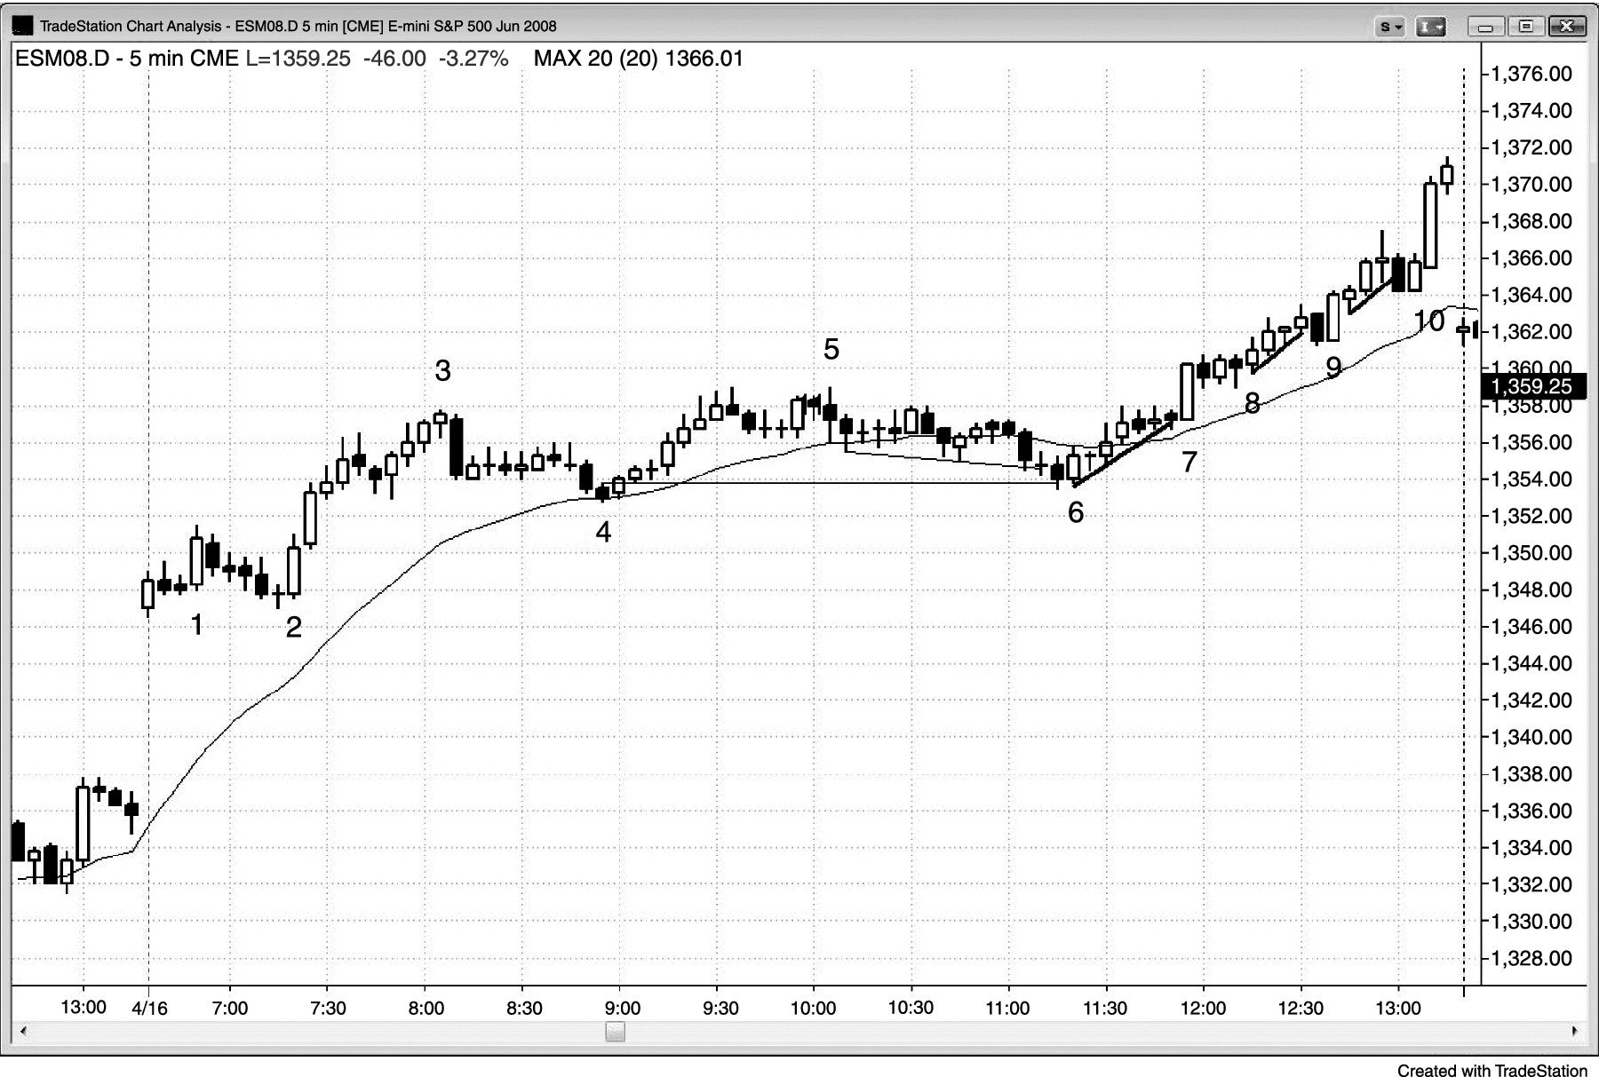
FIGURE 25.1 Gap Test after a Gap Up

Slide 2
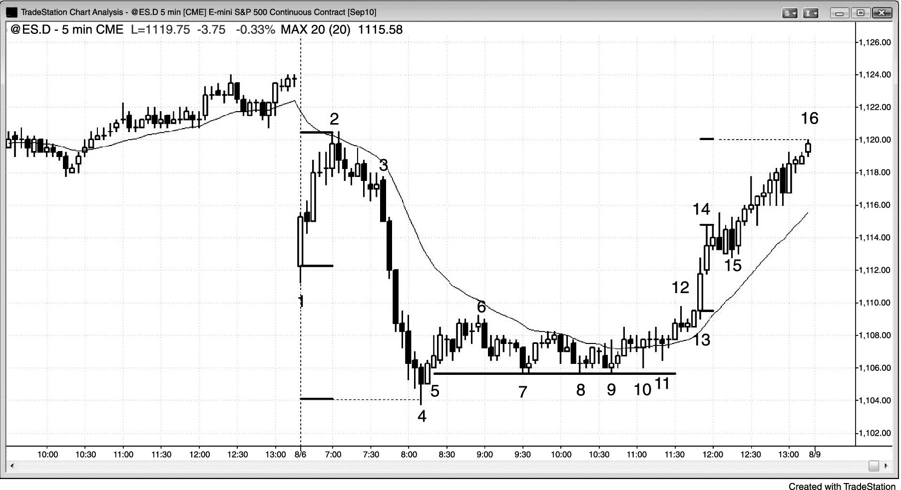
FIGURE 25.2 Tight Trading Range and Then a Reversal

Slide 3
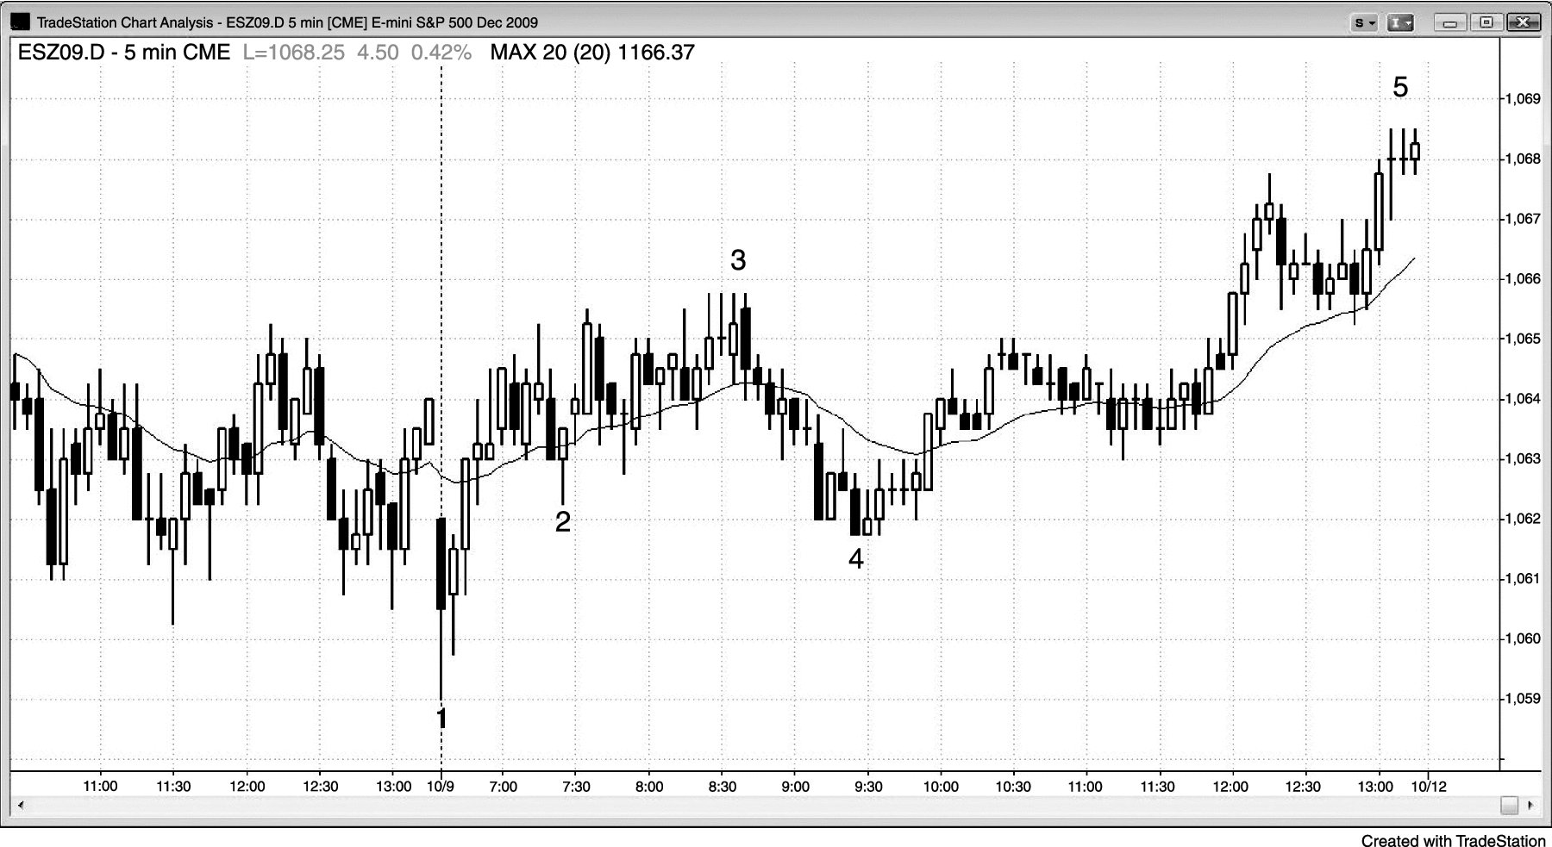
FIGURE 25.3 Trend Resumption

Slide 4
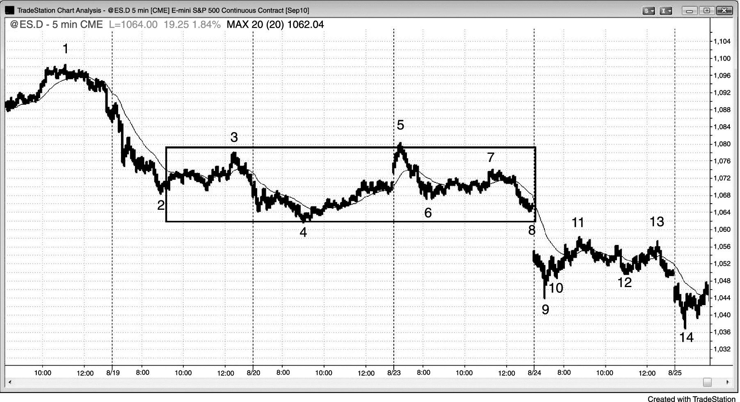
FIGURE 25.4 Trend Resumption after Several Days

